Slide 1
Vehicle Sales analysis
Nicholas SUtanto

Slide 2
Agenda
Data Introduction
Processes
Exploratory Data Analysis
Machine Learning
Recommendations
The Three Ws

Slide 3

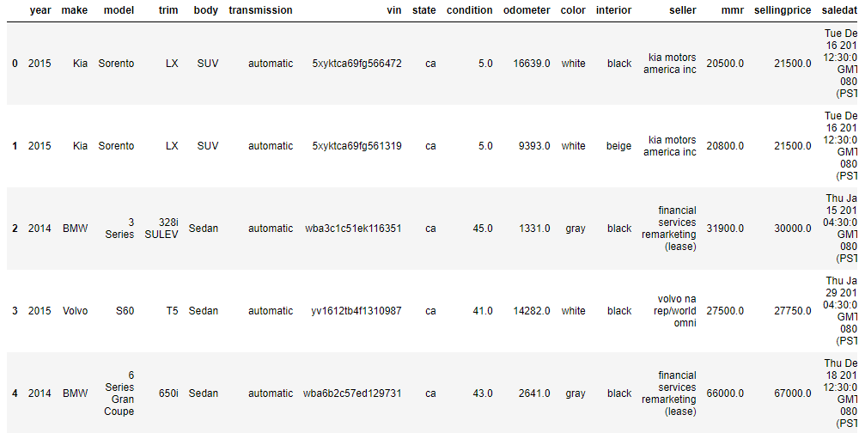
Introduction to the data
The dataset contains information regarding vehicle sales. The purpose of this analysis is to see what variables affect the selling price of a vehicle. The dataset consists of 558838 rows and 16 columns.
The variables include: year, make, model, trim, body, transmission vin, state, condition, odometer, color, interior, seller, mmr, selling price, and sale date.

Slide 4

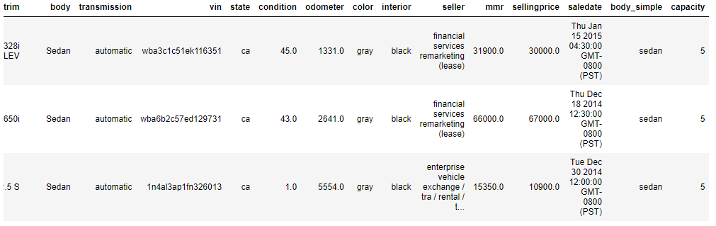
Processes​
I used python to preprocess the data.
Removed missing values (resulting in 472325 rows left).
Filtered the dataset to only using 9 vehicle makes from 3 regions (53 total makes, lowered down due to processing times/load. Resulting in a final row count of 275642).
Created 2 new variables, body_simple, and capacity.
Used python for feature importance and correlation matrix.
Use PowerBI and python for visualizations.

Slide 5
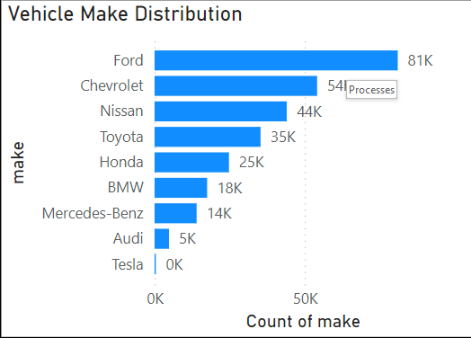
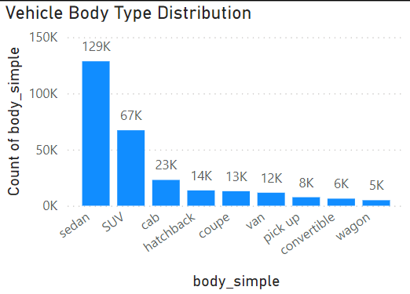
Exploratory Data Analysis
The most popular make is Ford, followed by Chevrolet then Nissan
The sedan body type is the most popular followed by SUV then cab.

Slide 6
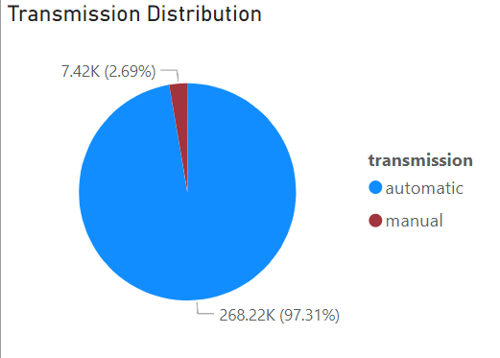
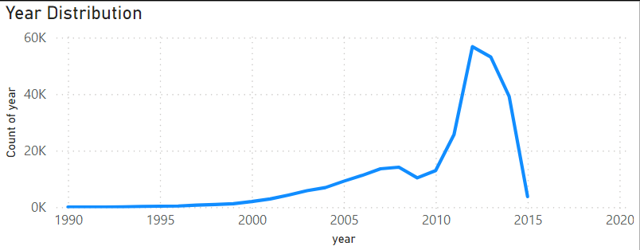
Exploratory Data Analysis
There is a large jump of number of vehicles from 2010-2012. Then it starts to lower again.
The majority of vehicles have an automatic transmission.

Slide 7
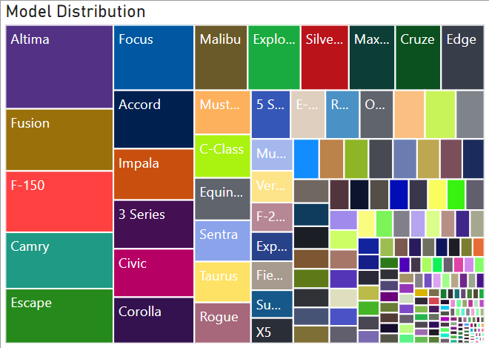
Exploratory Data Analysis
The most popular vehicle in the dataset is a Nissan Altima.

Slide 8
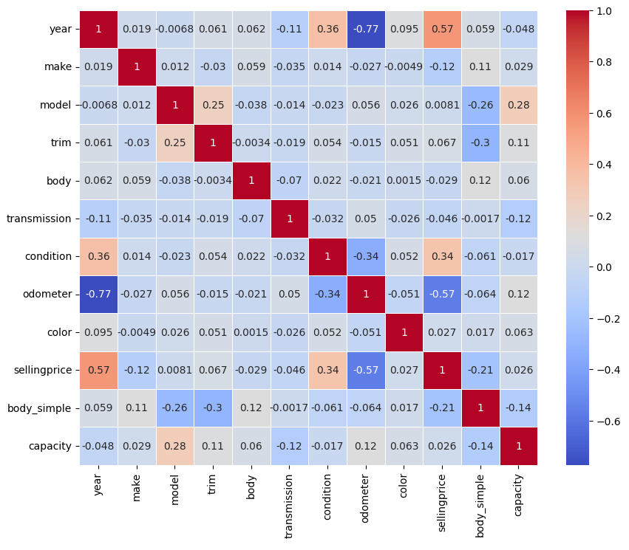
Exploratory Data Analysis
Used a heatmap to map out the correlation
Variables that are most correlated with selling price are year, condition, and odometer.
Some other notable correlations include:
Odometer and Year.
Condition and Year.

Slide 9
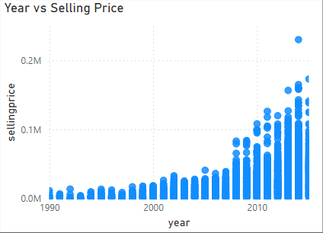
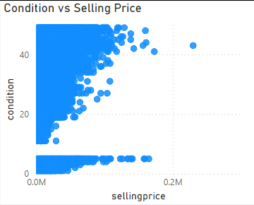
Exploratory Data Analysis
The chart shows that as the vehicle year increases, the selling price also increases.
Selling price increases as condition increases.

Slide 10
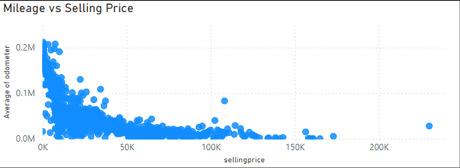
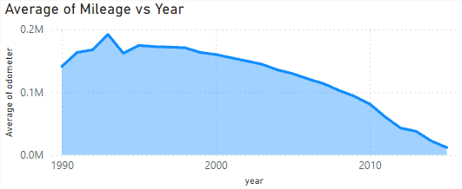
Exploratory Data Analysis
Selling price increases with lower mileage.
The newer the vehicle, the less mileage it has.

Slide 11
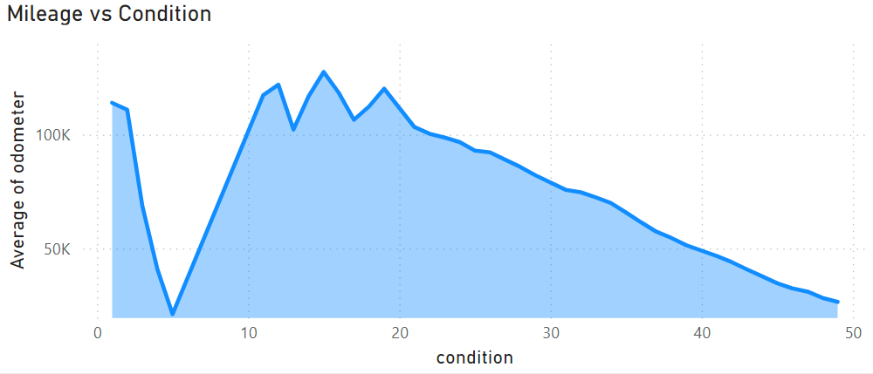
Exploratory Data Analysis
The higher the condition, the lower the mileage.

Slide 12
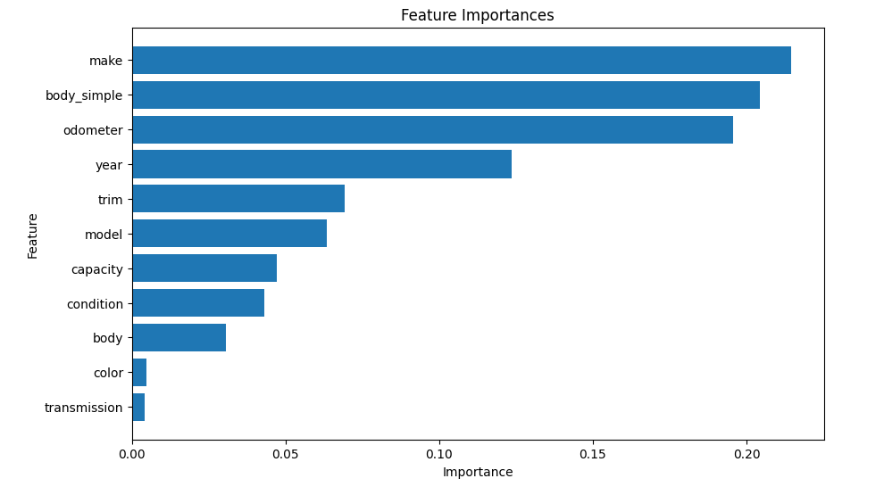
Machine Learning
This chart shows the variables that effect the machine algorithm the most.

Slide 13
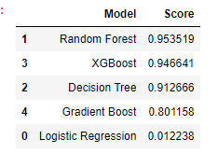
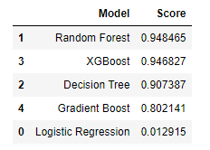
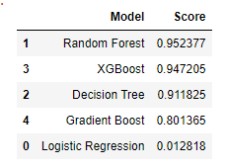
Machine Learning
Predictors 1.
Predictors 2.
Predictors 3.

Slide 14
Recommendations
Sell more Ford, Chevrolet and Nissan vehicles.
Sell newer vehicles. (2011-2014).
Random Forests is the best model for price predictions.
Charts show that these are the top 3 most popular vehicles.
Most popular sold vehicles are from the years 2011-2014.
Highest accuracy among used algorithms.
Customers seem to prefer American and Japanese vehicles.
Can be sold for a higher price to increase returns.
On average, these vehicles are lower priced.
Lower mileage.
All variables are important.
Sell vehicles in good condition.
2nd highest correlation with selling price.
Better condition allows for a higher selling price.

Slide 15

The Three Ws​
What went well
What did not go well
What I would do differently
Improved my Python understanding.
Practiced more on PowerBI.
Data was easy to work with.
Processing times were long.
It was hard to find multiple datasets that work together.
Hard to find ideas for topics.
Use multiple datasets.
No major issues.
Good results from the analysis.
Use different tools.
Use a more complex topic.

Slide 16
THANK YOU!

